Slide 1


BACHELOR OF INFORMATION TECHNOLOGY
(Data Science)
WEEKLY UPDATE - FINAL YEAR PROJECT
Developing Web-Based Competitive Analysis of Direct Mail Marketing in US Financial Institutions
Name: Nur Farahanis Binti Khadir
Matric ID: B23761093
Supervisor: Zainul Akramin Bin Mohd Drus
Date: 25th August 2025

Slide 2
TABLE OF CONTENTS
1
INTRODUCTION
2
WHY THIS PROJECT MATTERS?
RESEARCH AIM
RESEARCH OBJECTIVE
3
4
RESEARCH QUESTION
REVIEW SIMILAR SYSTEMS
5
6

Slide 3
TABLE OF CONTENTS
METHODOLOGY
AGILE APPROACH
7
8
9
DATA COLLECTION TECHNIQUES
10
PROGRAMMING LANGUAGE USED
SPRINT PLANNING & EXECUTION
DATA COLLECTION AND TREND ANALYSIS
11
12

Slide 4
Developing a Web-Based DM Dashboard for
US Financial Sector

Slide 5
INTRODUCTION
CHAPTER 1

Slide 6

INTRODUCTION
Building a web-based analytics platform to compare direct mail (DM) marketing trends among major financial institutions in the United States. The goal is to help banks improve their marketing strategies by analyzing patterns in monthly spending and mail volume. By using tools like Python, MySQL, and Streamlit, this platform allows marketing analysts to easily access, visualize, and interpret DM data. It aims to support better decision-making and give banks a competitive edge through data-driven insights
CHAPTER 1

Slide 7
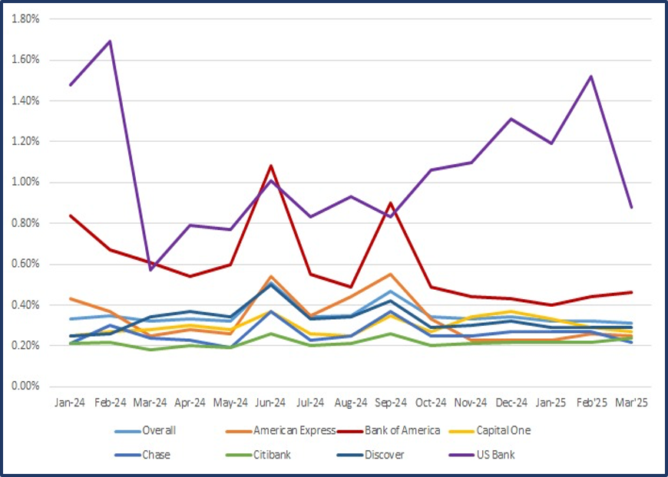
WHY THIS PROJECT MATTERS?
Financial institutions rely heavily on data-driven decisions to optimize marketing and improve ROI.
Direct Mail (DM) still plays a major role in customer acquisition, especially in highly regulated sectors like banking.
DM boasts 80–90% open rates and up to 112% ROI, outperforming email and other digital channels (Media Logic, 2022).
Despite its effectiveness, there is no centralized, real-time platform for comparing DM campaign performance across competing banks.
Current tools are often costly, complex, or lack competitor benchmarking features.
DM Response Rates (%) by FI

Slide 8
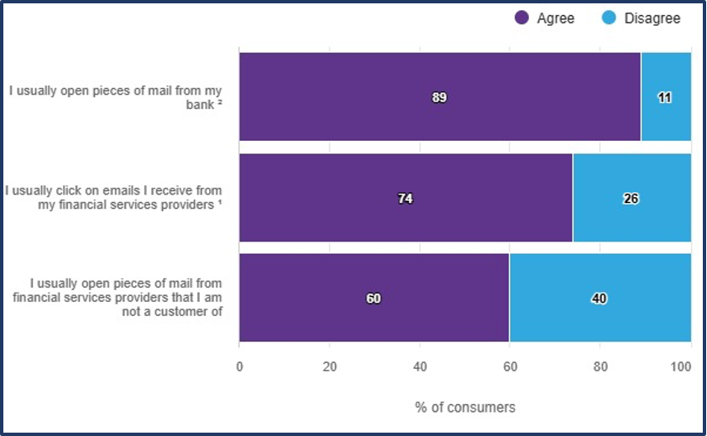
RESEARCH AIM
To address the following problems:
Financial institutions struggle to analyze direct mail campaigns effectively
Marketing data is scattered and lacks centralized insights
No existing tools to compare competitor strategies
Urgent need for a simple, accessible web-based analytics platform
Lack of time-based trend analysis across major banks
Analysts need actionable insights to improve campaign performance
US Consumer Responses to DM vs. Email

Slide 9
RESEARCH OBJECTIVE
THE GOAL
OUR AIM
Organizes DM data from major US banks into a structured, query-friendly format.
Supports real-time insights for quicker, more informed decision-making.
Enables CSV report downloads for extended offline planning.
Visualizes marketing performance via interactive Streamlit dashboards.
Empowers marketing analysts with intuitive, data-driven tools for strategic planning.
Support marketing analysts with user-friendly and data-driven tools.

Slide 10


RESEARCH QUESTION
Which tools and technologies are best suited for developing an intuitive, data-driven platform?
How can web-based dashboards optimize data accessibility and decision-making?
What are the key direct mail marketing trends among major US banks?
How can comparative analysis help financial institutions improve their marketing strategies?
04
03
02
01

Slide 11
BACKGROUND OF STUDY
CHAPTER 2

Slide 12




REVIEW SIMILAR SYSTEMS
MINTEL COMPEREMEDIA DIRECT
DUN & BRADSTREET MARKETING ANALYTICS
TABLEAU MARKETING ANALYTICS
SALESFORCE MARKETING CLOUD
(DM INTEGRATION)
Purpose: A platform for analyzing direct mail strategies and competitor performance.
Strength: Gives full marketing data and insights on competitors.
Weakness: Needs high cost and staff training to use fully.
Purpose: Improves campaign targeting and tracks performance using business data.
Strength: Offers wide business data and analytics.
Weakness: Focuses more on B2B, not ideal for B2C marketing.
Purpose: Visualizes marketing data like social media, ads, and customer journey.
Strength: Strong data visualization for better decisions.
Weakness: Can be hard to use for beginners without analytics experience.
Purpose: Manages automated marketing journeys across email, social media, and direct mail.
Strength: One platform for multi-channel campaigns.
Weakness: Needs technical skills and resources to set up and use well.

Slide 13
METHODOLOGY
CHAPTER 3

Slide 14
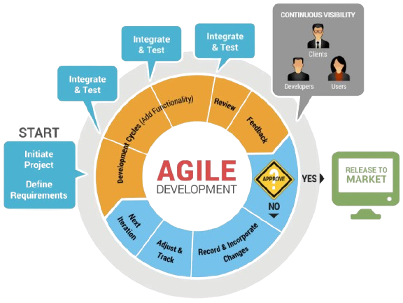
AGILE APPROACH
Purpose of Choosing Agile
Strengths of Agile
To build the dashboard (Streamlit) in small, manageable steps.
To align with the dynamic nature of data analytics and dashboard development.
To ensure user needs are captured and reflected in real time.
Iterative development: Enables continuous improvement based on feedback.
Flexibility: Easily adjust to changes or enhancements during development.
Collaboration: Involves users (e.g., financial analysts) at each stage for better results.
Faster delivery: Short cycles allow quicker testing, deployment, and value creation.
Risk management: Early issue detection and task prioritization reduce overall risk.
How It’s Implemented in the Project
Development divided into phases - database, data processing, visualization, and user interaction.
Regular user feedback gathered via paper prototypes and testing.
Continuous updates made based on feedback to meet stakeholder needs.
Clear visibility of progress helps maintain stakeholder engagement and satisfaction.

Slide 15

DATA COLLECTION TECHNIQUES
01
02
Interviews
I interviewed marketing analysts, data analysts, and bankers I know to gather ideas and real-time needs for dashboards.
Questionnaires
I sent online surveys to people in finance to find out preferred features, visualizations, and user needs.
Observations
I observed users testing my prototype to identify problems, improve usability, and confirm the dashboard supports data analysis well.
Third-Party Data
I used data from Comperemedia Direct to provide real-world direct mail marketing trends for better analysis and benchmarking.
03
04

Slide 16




PROGRAMMING LANGUAGE USED
Python
A programming language used for data analysis and back-end logic.
→ Helps process and analyze large datasets quickly.
MySQL Workbench
A tool to manage and design databases.
→ Stores and organizes data for easy access and queries.
Streamlit
A Python tool for building web dashboards.
→ Makes the dashboard interactive and easy to use.
CSV Export
A file format for importing/exporting data.
→ Lets users download reports or upload raw data for analysis.

Slide 17
SPRINT PLANNING & EXECUTION
Sprint 0: Planning & Setup
Planned the project.
Listed all requirements, chose tools like MySQL, Python, and Streamlit, and created the timeline.
Sprint 1: Database & Layout Design
Designed the database using ERD and built the basic layout of the dashboard using Streamlit.
Added test data into the MySQL database.
Sprint 2: Data Collection & Cleaning
Collected raw data and cleaned it using Python (Pandas).
Handled missing or incorrect data to make it ready for analysis.
Sprint 3: Trend Analysis & Visualization
Analyzed trends like spending and mail volumes
Used charts to show the results clearly.
Sprint 4: Dashboard Features
Completed the dashboard by adding filters, dropdown menus, and a button to download data as CSV.
Sprint 5: Testing & Debugging
Tested everything like filters, charts, download button and fixed any issues.
Sprint 6: Report Writing
Finished writing the report, added charts and screenshots, and formatted everything properly.
Sprint 7: Final Submission
Finally, I submitted the full project and gave a presentation with a live dashboard demo.

Slide 18
DATA COLLECTION AND TREND ANALYSIS
CHAPTER 4

Slide 19
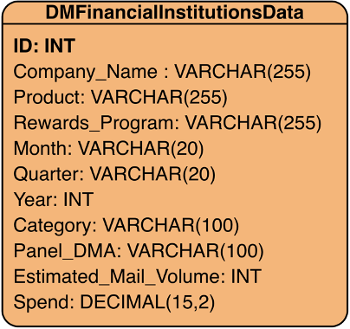
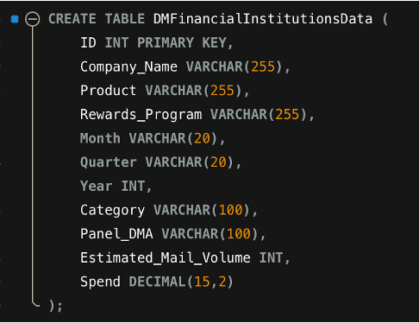
1. DATA COLLECTION
2. DATABASE DESIGN WITH MYSQL
To prepare an analytic dashboard, data from Third-Party Acquisition loaded into MySQL for analysis.
Collected key details like Company Name, Product, Rewards Program, Month, Date, Panel DMA, Estimated Mail Volume, and Spending (USD).
Data mainly sourced from top U.S. banks (e.g., Bank of America, Citibank, American Express).
To provides foundation for competitive analysis in direct mail marketing.
Entity Relationship Diagram (ERD)
Unstructured raw data existed in multiple formats, requiring restructuring.
Designed a relational database in MySQL Workbench for organized storage.
Applied data normalization to reduce redundancy and ensure consistency.
Created clear links between tables and bank names for easier data access.
Enabled advanced functions: indexing, filtering, and aggregation for large time-series datasets.
Delivered a well-structured schema that simplifies analysis, comparisons, and integration with visualization tools.
Create table & Inserting data into MYSQL

Slide 20
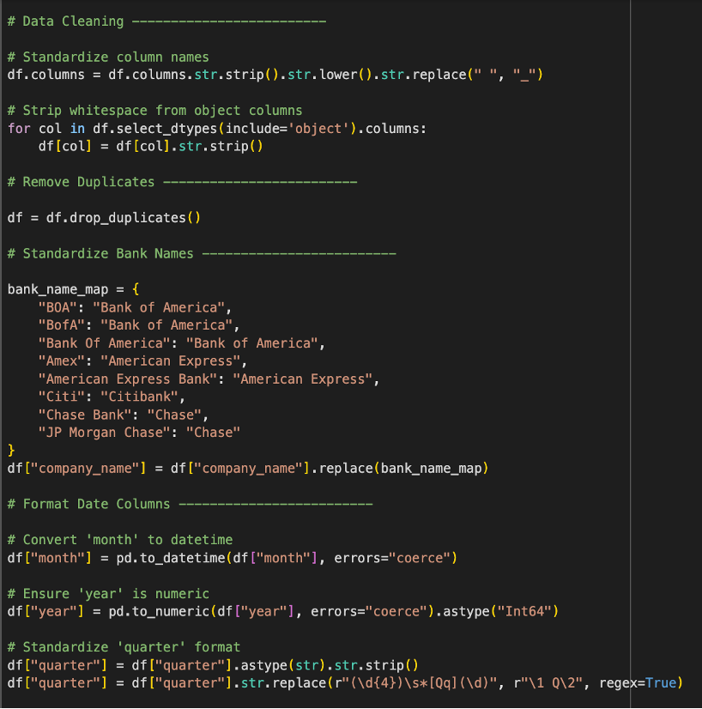
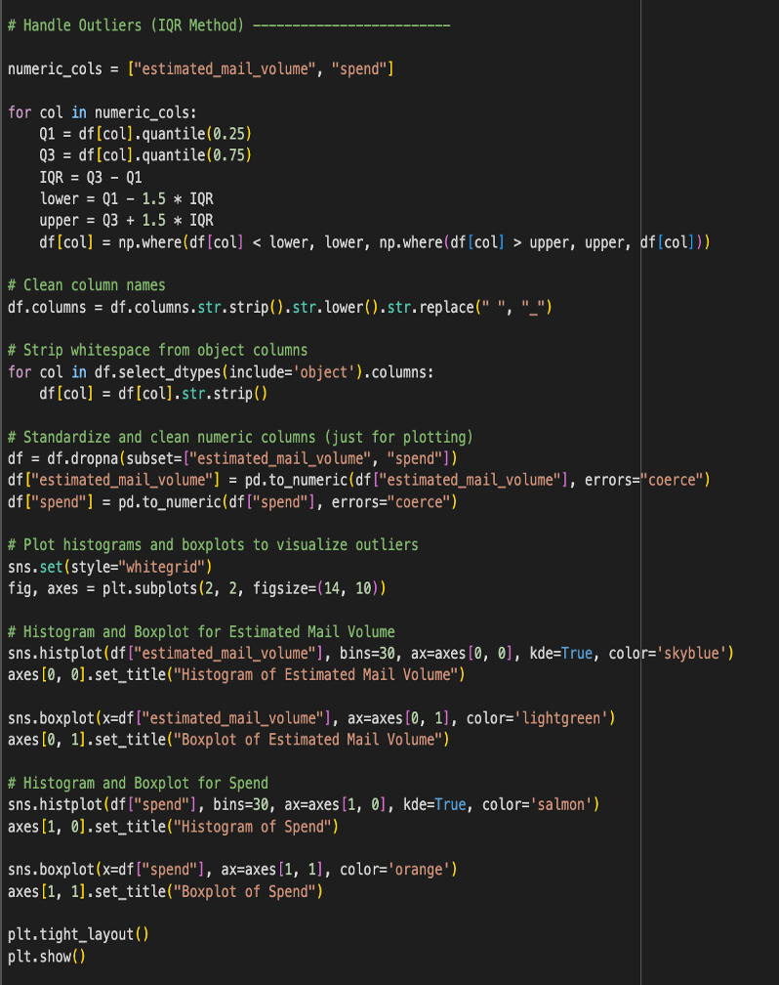
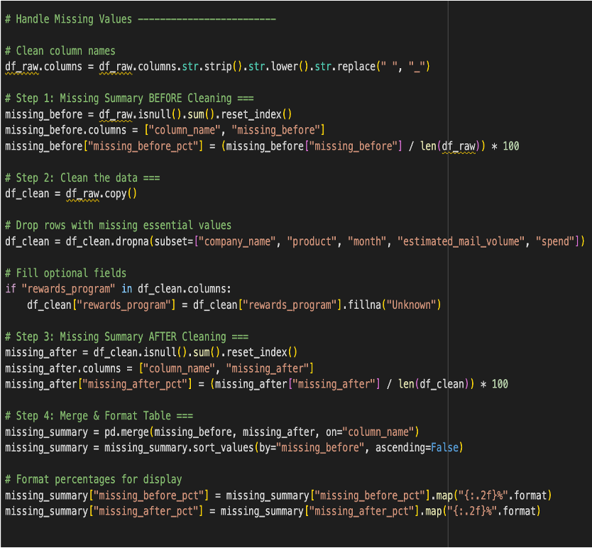
3. DATA PREPROCESSING WITH PYTHON
Data Cleaning
Cleaned & structured dataset to make it ready for analysis
Removed duplicates to maintain data validity.
Standardized bank names (e.g., BOA → Bank of America) for consistency.
Transformed dates into Month, Quarter, and Year for time-based analysis.
Handled missing values – filled non-critical fields with “Unknown.”
Dropped rows with missing critical fields (Company, Product, Month, Spend, Mail Volume).
Standardized column names (lowercase, underscores) for uniformity.
Converted data types (text → categorical, numeric fields → proper format).
Result: High-quality, consistent, and structured dataset ready for queries, visualization, and ML.
Handle Outliers
Handle Missing Value

Slide 21
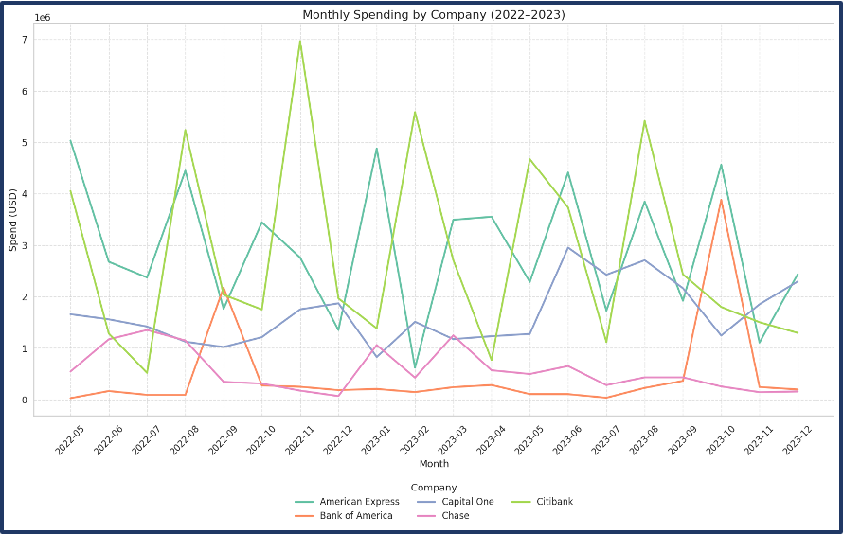
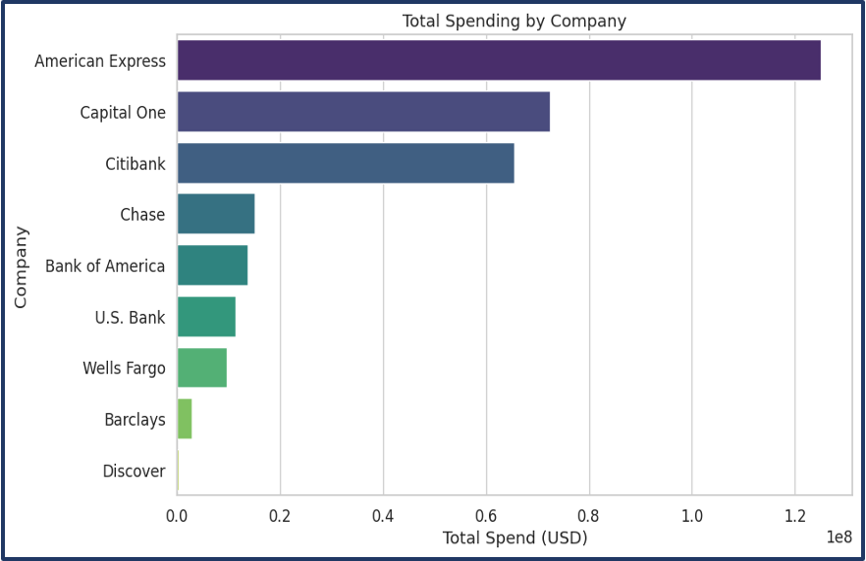
4. CONDUCT TREND ANALYSIS
Trend Analysis Approach
Created new date columns (Year, Year_Month) for temporal patterns.
Used Matplotlib & Seaborn to plot spending and mail volume trends.
Consistent column naming ensured smooth comparison.
Spending Trends
Line graph: Monthly spending (2022–2025) → seasonal & yearly variations.
Top 5 spenders per month identified using .nlargest().
Bar chart: Total spending per company → major players over full dataset. Category analysis: Top card categories by spend across banks.
Mail Volume Trends
Bar chart: Monthly mail volume fluctuations (2022–2025).
Company-wise comparison of mail volume.
Pie chart: Top 5 DMA regions by mail volume.
Comparative Statistics
Pivot tables: Annual & quarterly spending across banks.
Identified top 3 institutions per year for competitive insights

Slide 22
SYSTEM DESIGN AND DEVELOPMENT
CHAPTER 5

Slide 23
CONCLUSION
This project demonstrates how direct mail marketing data can be used to improve marketing strategies for financial institutions. By analyzing trends such as monthly spending and mail volume across US banks, useful insights can be gained to help banks stay competitive.
The dashboard developed using Python, MySQL, and Streamlit allows for easier access, understanding, and interpretation of the data. Overall, this project has helped enhance my skills in data analysis, dashboard development, and solving real-world problems. The platform has strong potential to support effective decision-making in actual marketing practices.

